Slide 1
MI-SIG Presentation
Topic: Predict Stock Prices from news articles

Slide 2
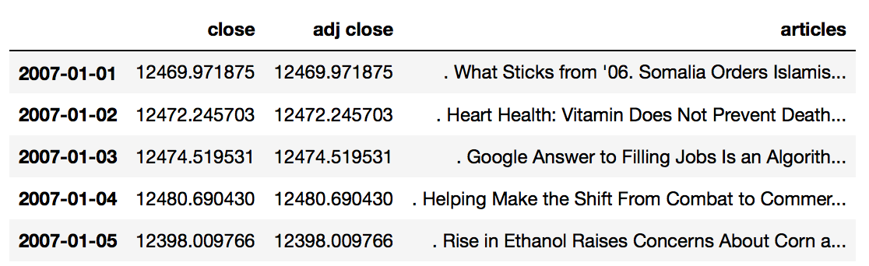
Dataset
Data -> DJIA index prices
The main dataset consists of 3 columns as close price, adj close price and the articles for the given index date.
The dates are the index and range from 2007-2016
The news articles are from NY Times

Slide 3
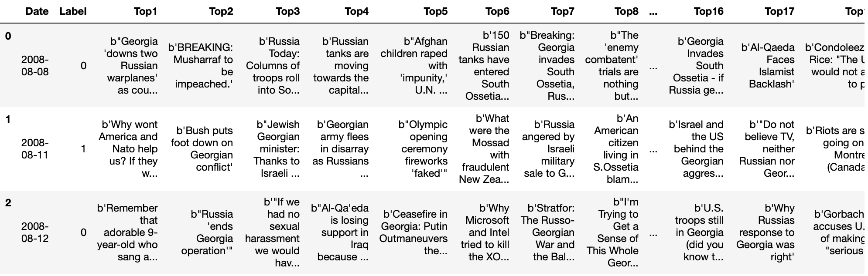
Addition of news data
I also added the reddit news data 2008-2016 to the dataset corresponding to the dates. The data consisted of top 20 news headlines.

Slide 4
Data Preprocessing
The articles column from the dataset was preprocessed by ignoring the stopwords, normalizing it and then lemmatization was applied.
Lemmatization is the process of converting the words of a sentence to its dictionary form.

Slide 5
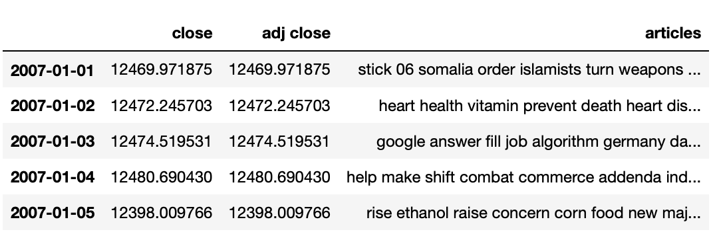
Preprocessed data

Slide 6

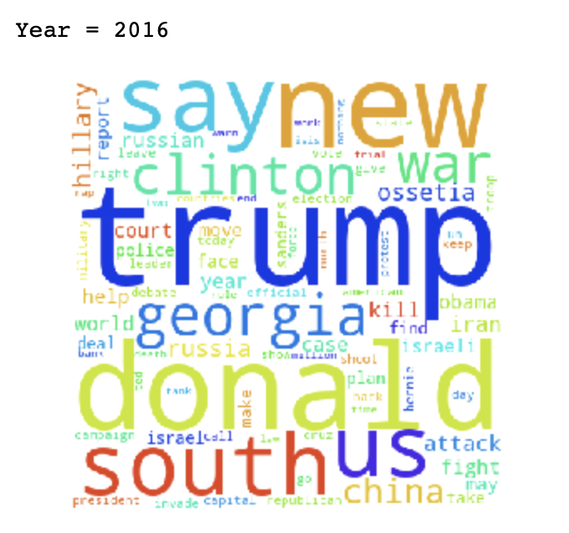
Some of the important terms in the news which occurred frequently

Slide 7
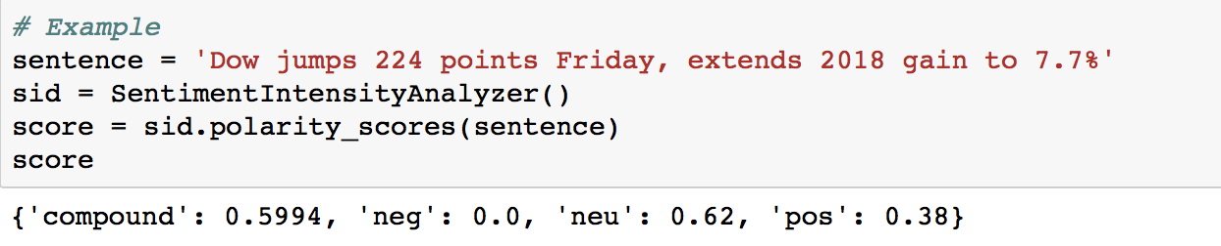
Sentiment Analysis
I have used the popular sentiment analyzer used in NLP, i.e. Vader Sentiment Analyzer and extracted the positive, neutral, negative and total sentiment value from the given news article.

Slide 8
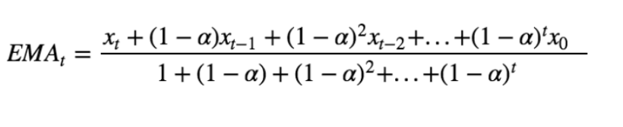
What is SMA and EMA??
SMA (Simple Moving Average) is an average found by computing the average price of the stock price over a period range. The problem with this is that it introduces lag, i.e. the SMA for a day is lower than the current price at that day.
To overcome that problem, we use EMA (Exponential Moving Average)
Exponential moving averages (EMAs) reduce the lag by applying more weight to recent prices.
X_{t} = Stock Price at time t , α = decaying factor. We can implement EMA by pandas ewm function

Slide 9
Addition of Features
In order to get more accurate prediction on the given dataset, I have added two more features in the dataset which are widely used for finding the trend in stock prices.
MACD (Moving Average Convergence Divergence)
Stochastic Oscillator

Slide 10
MACD
The moving average convergence divergence (MACD) is a technical momentum indicator, calculated for use with a variety of exponential moving averages (EMAs).
Steps:
1) Calculate a 12-period EMA of price for the chosen time period.
2) Calculate a 26-period EMA of price for the chosen time period.
3) Subtract the 26-period EMA from the 12-period EMA.
4) Calculate a nine-period EMA of the result obtained from step 3.
The MACD Line is the 12-day Exponential Moving Average (EMA) minus the 26-day EMA.
Closing prices are used for these moving averages.
A 9-day EMA of the MACD Line is plotted with the indicator to act as a signal line and identify turns.

Slide 11

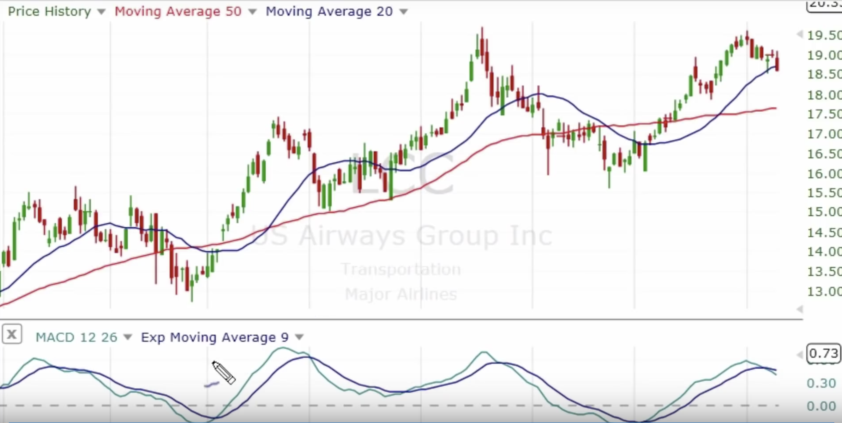
The MACD Histogram represents the difference between MACD and its 9-day EMA, the signal line.
The histogram is positive when the MACD Line is above its Signal line and negative when the MACD Line is below its Signal line.

Slide 12
Stochastic Oscillator
The stochastic oscillator is a momentum indicator comparing the closing price of a security to the
range of its prices over a certain period of time.
Formula
%K line = 100(Current Close - Lowest Low)/(Highest High - Lowest Low)
%D line = 3-period moving average of %K
Where:
Current Close = the most recent closing price
Lowest Low = the lowest low for the previous period
Highest High = the highest high for the previous period

Slide 13
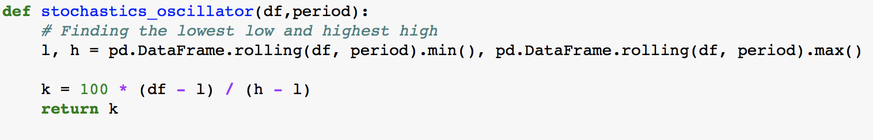
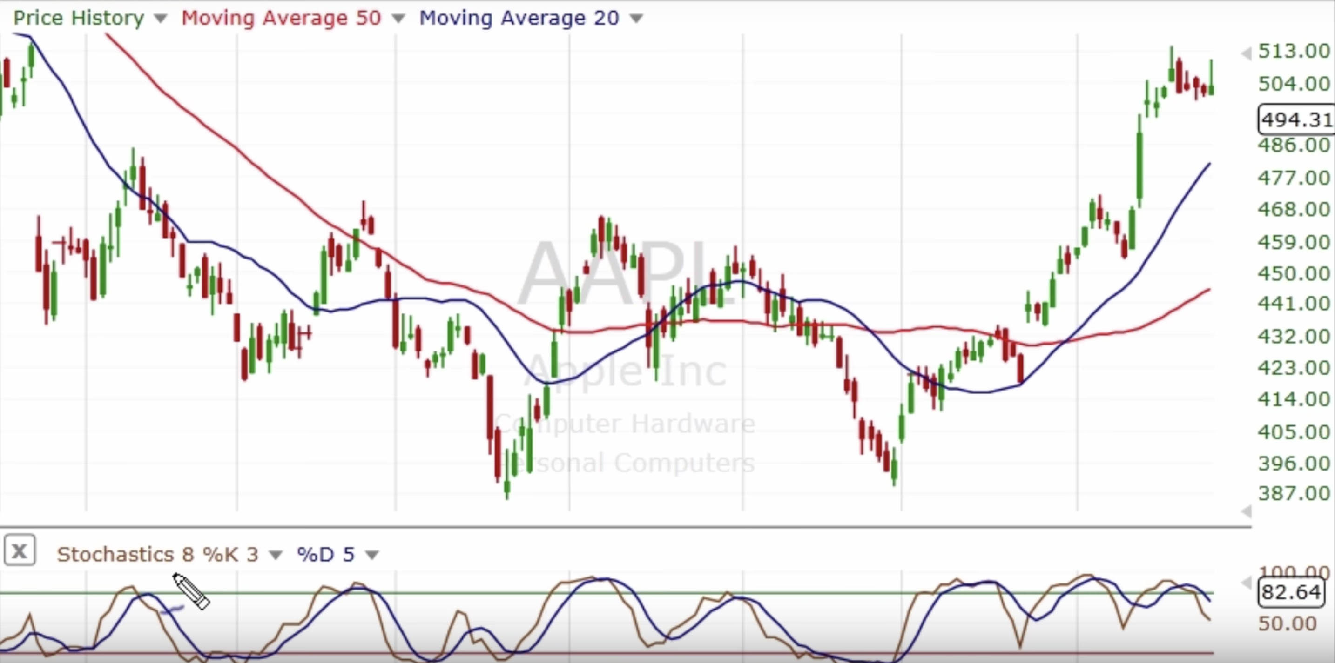

Slide 14
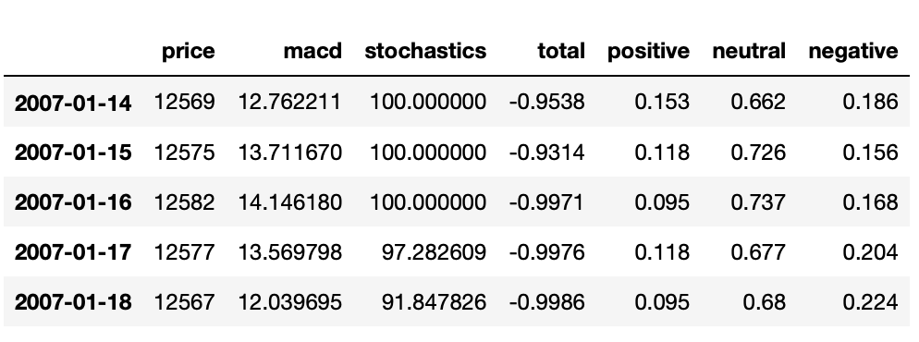
Final DataFrame
The modified dataframe has these columns after modifications..

Slide 15
Models Used
Linear Regression
Decision Tree Regressor
Random Forest Tree Regressor
Support Vector Regressor

Slide 16
Training and Testing Data
The training data is divided into data for days from 1st of Jan to 31st of October and the rest of the months is used as test data.
The training data is an array containing arrays having the close price, macd, stochastics, total, positive, neutral and negative as input.
This is done for every year and the model is fit for each one.
Also the smoothening of data was done

Slide 17
Smoothening the data
To smoothen the predicted data, the difference between the average real test price and the average predicted price on the test set for first 7 days is added to every data in the prediction.

Slide 18
Window Analysis for linear regression
I also tried out a window analysis of the data in which we predict the price of the stock by training the model in last 14 days and using the predicted data to move forward to predict the price on the next day.

Slide 19
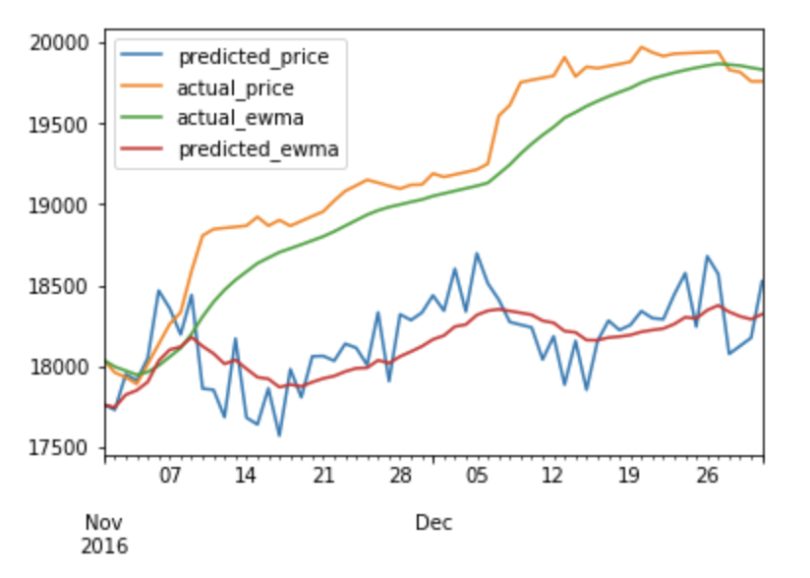
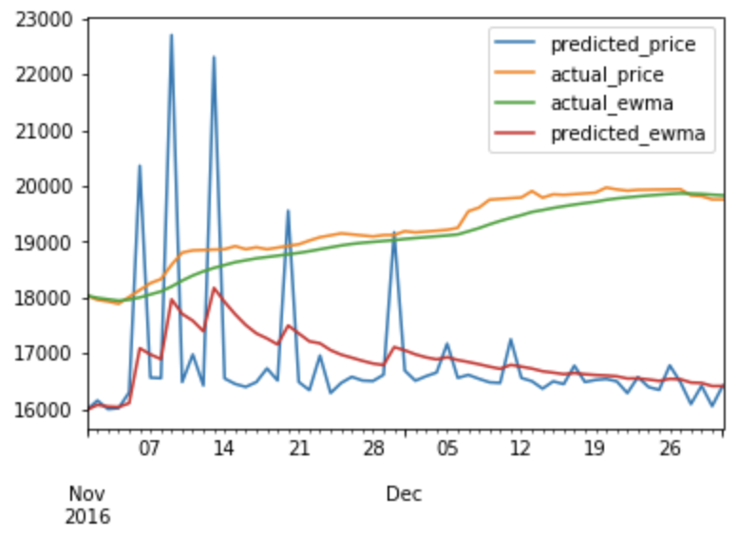
Linear Regression
When we simply fit the linear regression model to the data, the output is not so impressive.
By Normal Analysis
By Window analysis

Slide 20
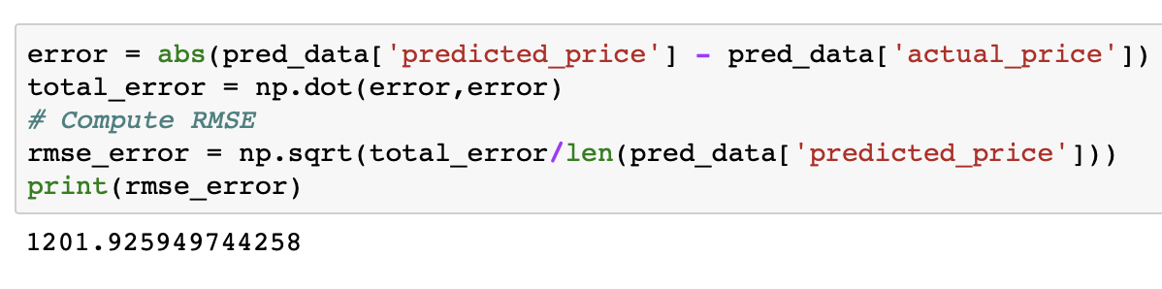

Slide 21
Implementing Ridge Regression
Ridge regression is the regularized version of Linear Regression. Depending on the value of regularization rate, the RMSE error decreases. Regularization helps in preventing overfitting by penalizing higher magnitude weights increasing the cost.
What does a large coefficient signify? It means that we’re putting a lot of emphasis on that feature, i.e. the particular feature is a good predictor for the outcome. The feature has a high capability of swinging the cost function to reach the minima.
This kind of model leads to overfitting.

Slide 22
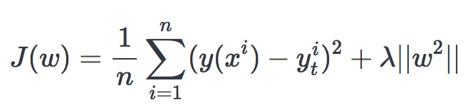
In Ridge regression (L2 regularization), a commonly used regularization technique, we add a penalty proportional to the squared magnitude of each weight.
λ is a hyper-parameter that we choose and decides the regularization strength. Larger values of λ imply more regularization, which reduces the w values.
Cost Function

Slide 23
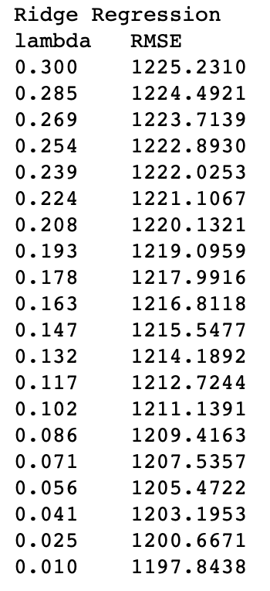
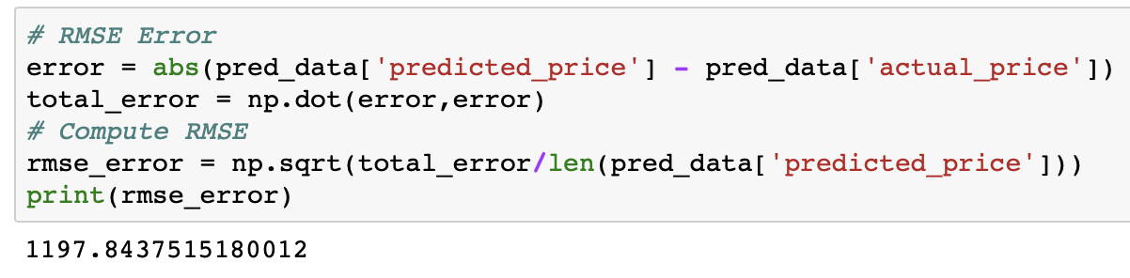
Regularized model leads to decrease in RMSE
We have to adjust the value of lambda to get optimize the model

Slide 24
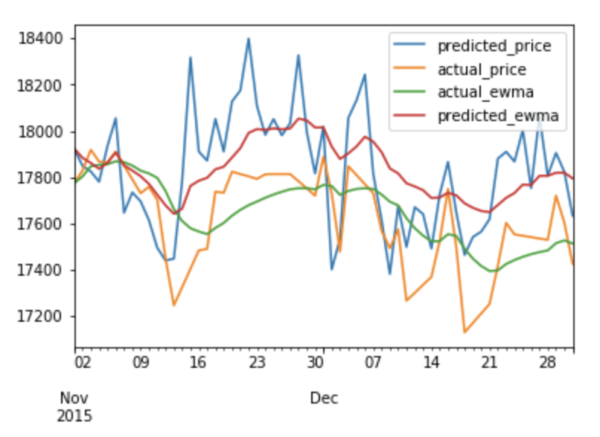
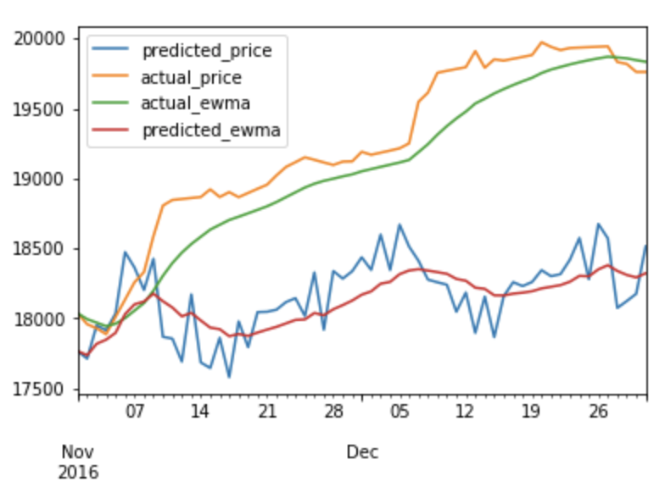

Slide 25
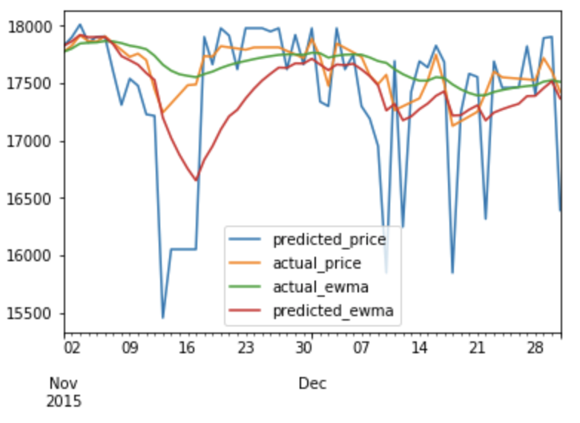
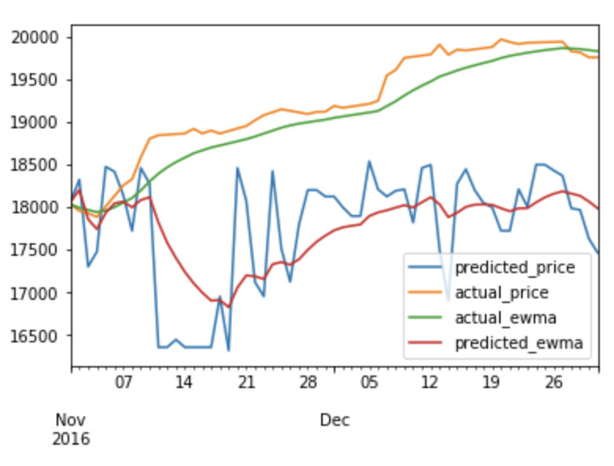
Decision Tree Regression
The regression is done by splitting the dataset based on an attribute after finding a optimal split. (lower cost)

Slide 26
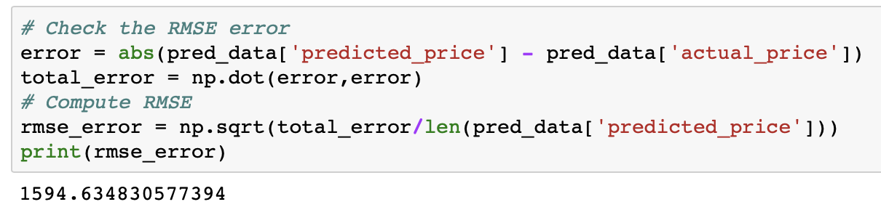

Slide 27
Bagging
What bagging basically does is it computes decision tree regression on resampled data and averages all the computed predicted values to find the predicted value.
We have implemented bagging with base model as decision regression tree (with different node depth values) and different no. of estimators to observe the change in RMSE error

Slide 28
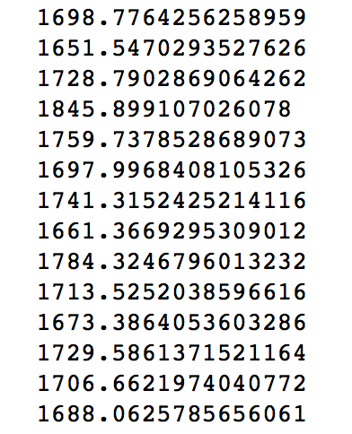
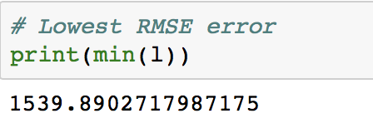
Some of the RMSE error values

Slide 29
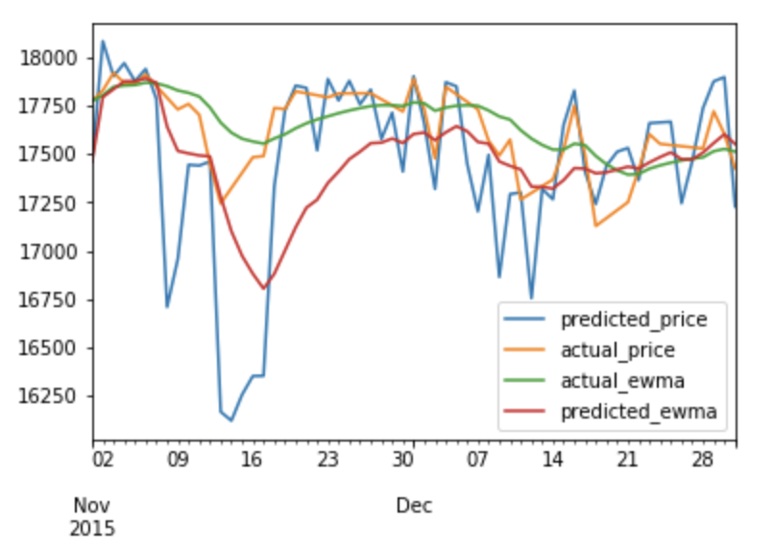
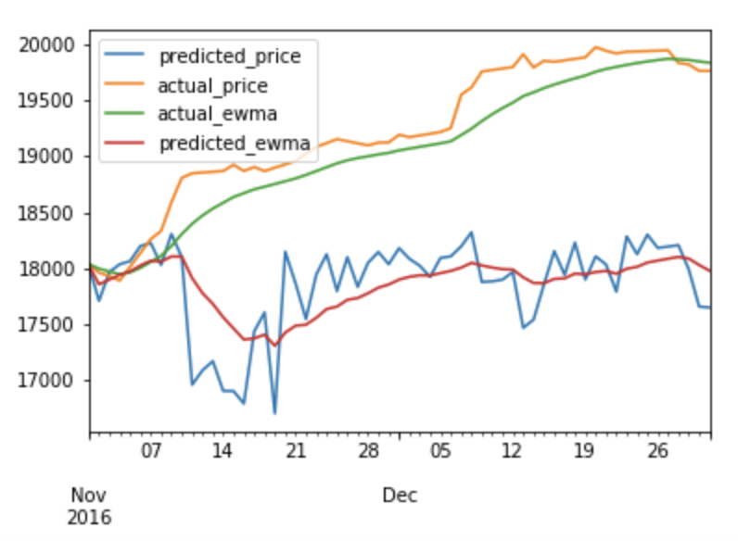
Random Forest Regression
It uses a lot of decision trees implementation to include all of the possible optimal trees formed by splits and averages the predicted values obtained from all trees as the predicted value.

Slide 30
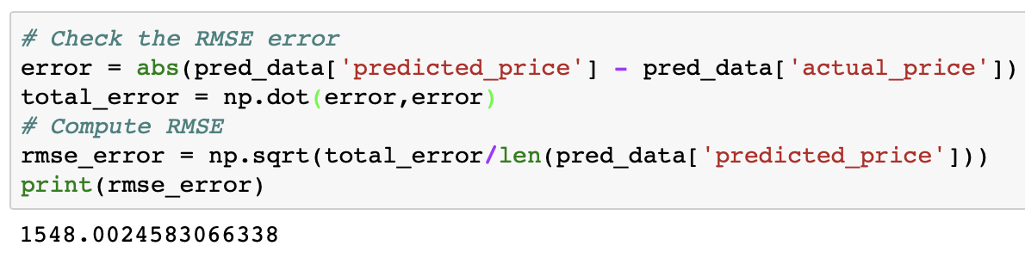
On observing, it has a good estimate of RMSE error and it is the best in capturing the intuition of rise and fall of stocks, probably the trees intuitively correctly predict the predicted price by capturing the region of where the input data belongs and gives it the value that all similar data in that region get.
All the data having similar parameters to the input data will have similar output; which is given to the input data. The value may be incorrect, but the property of rise and fall is correct most of the time.

Slide 31
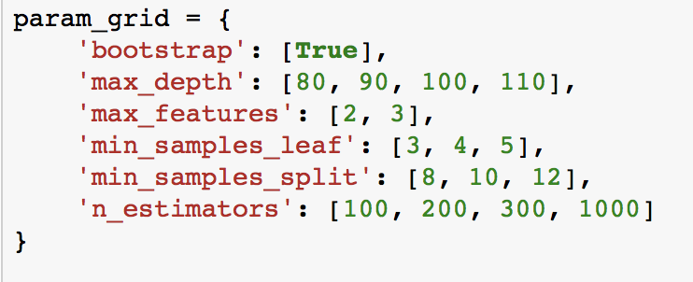
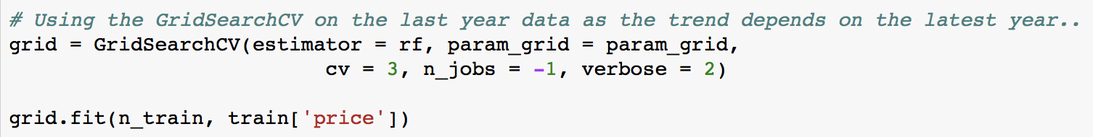
Finding the best parameters using GridSearchCV

Slide 32
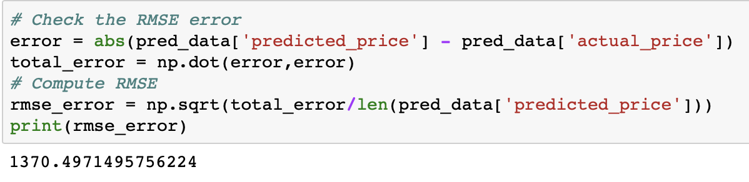
The best model is evaluated as the one with the highest accuracy.

Slide 33
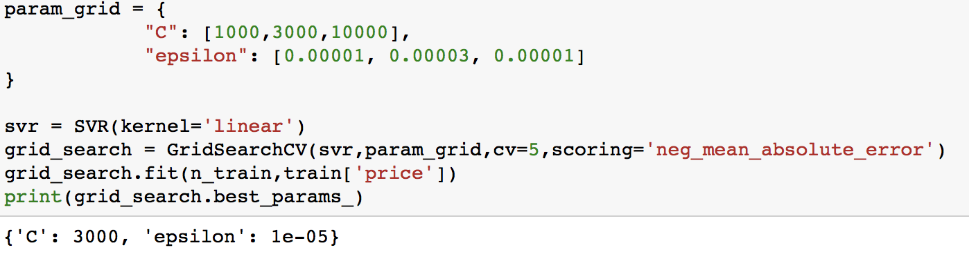
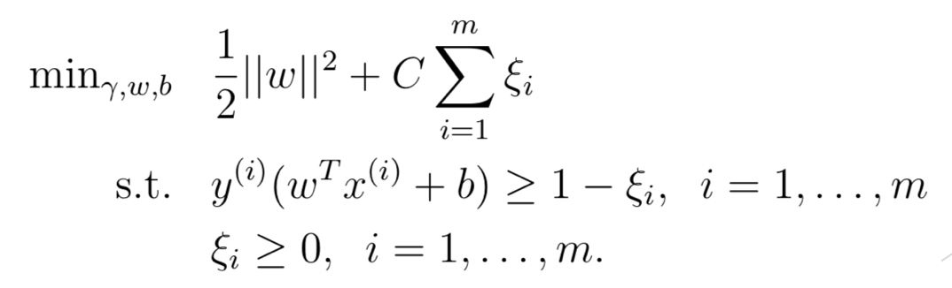
Support Vector Regression
Finding the best parameters

Slide 34
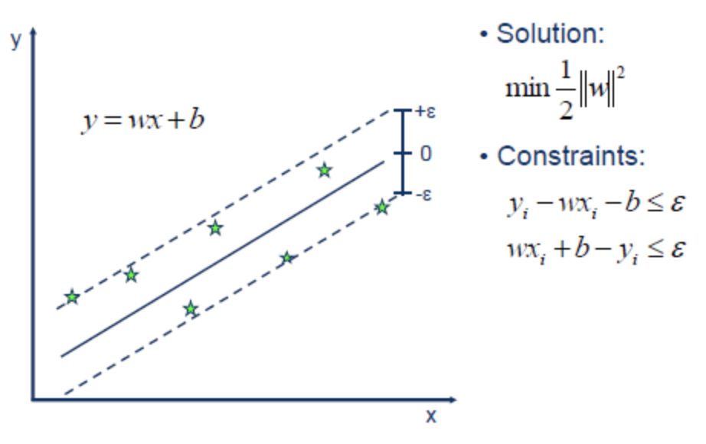
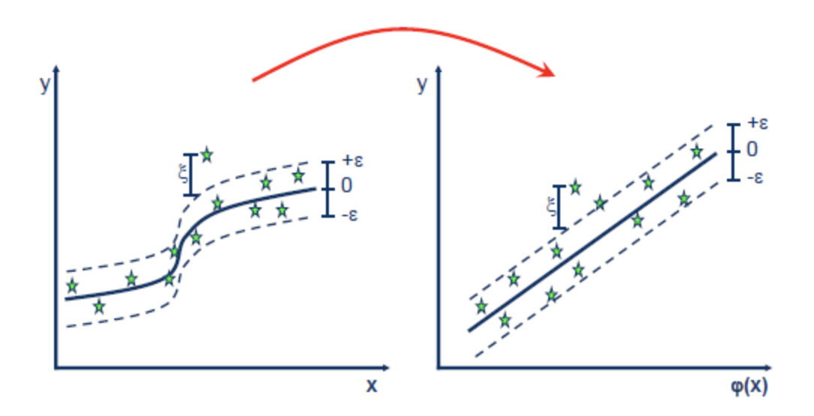
Idea
In case of Non-Linear Kernel
It transforms data from higher dimensional
space to linearly separate them

Slide 35
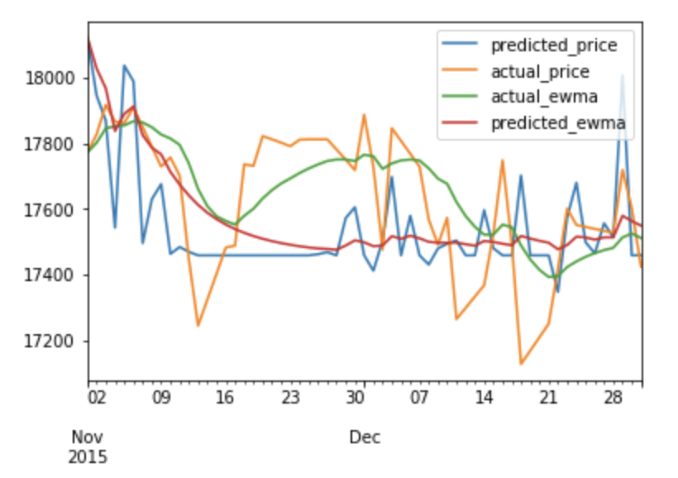
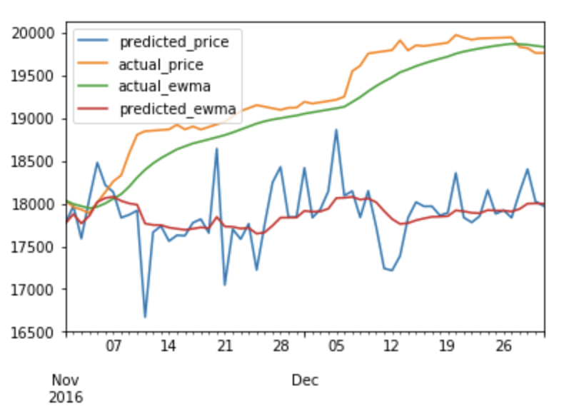
Using the linear kernel SVR

Slide 36
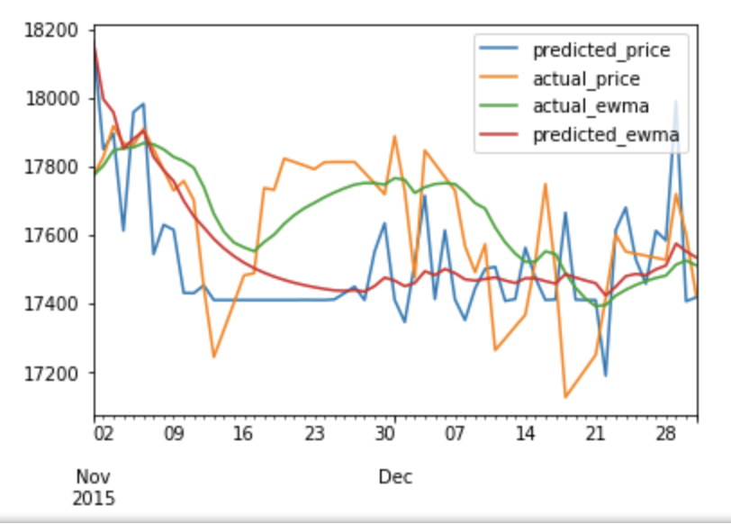
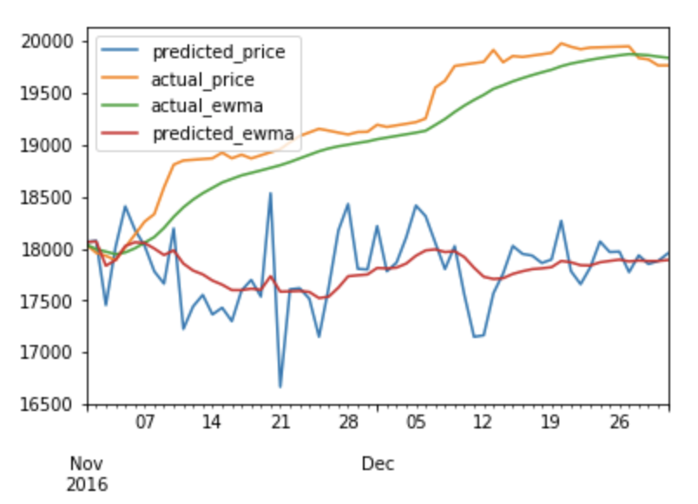
Using RBF kernel

Slide 37
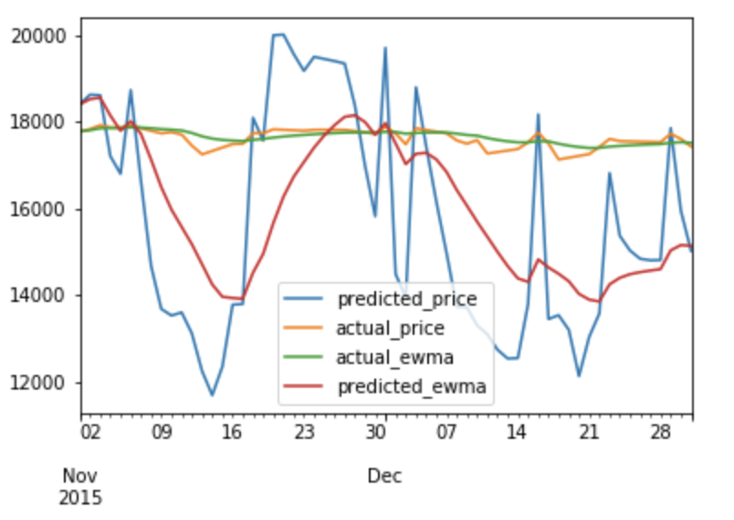
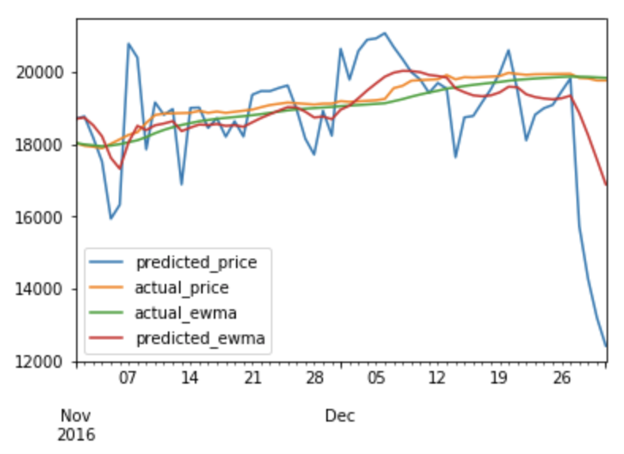
Going deep
I now applied neural network model with 4 hidden layers and kept the hyperparameters to some random values.

Slide 38
Analysis
The Random Forest tree model worked the best among the models tested. Perhaps the neural network can beat it if we can find out the optimal hyperparameters.

